Slide 1
Pandas

Slide 2
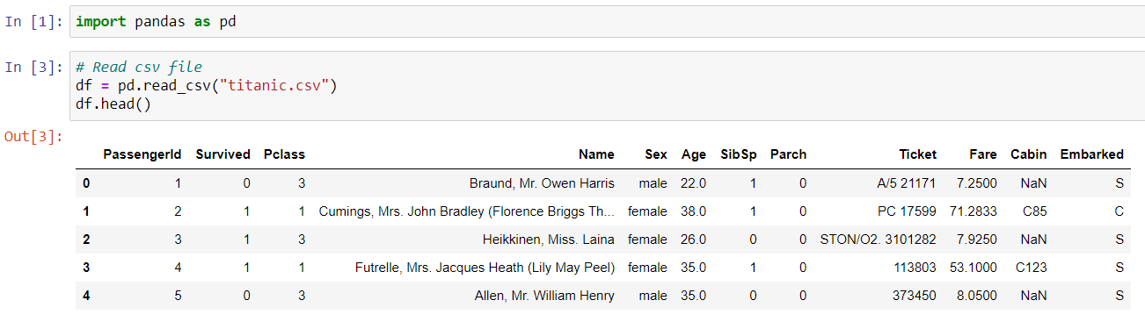
Read CSV

Slide 3
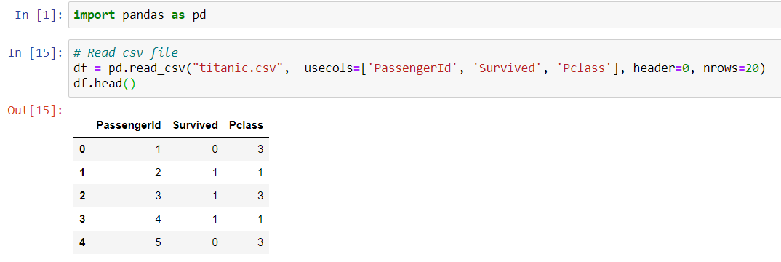
Read CSV

Slide 4
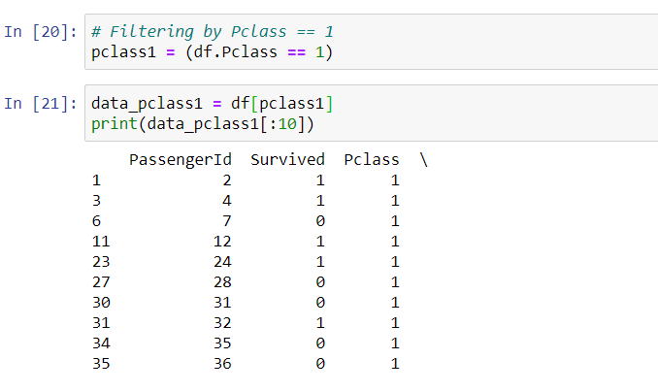
Filtering Baris
Filtering Pclass == 1

Slide 5
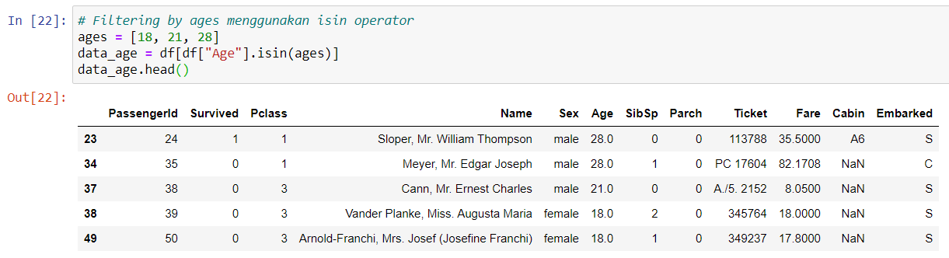
Filtering Baris
Filtering Age dengan isin method

Slide 6
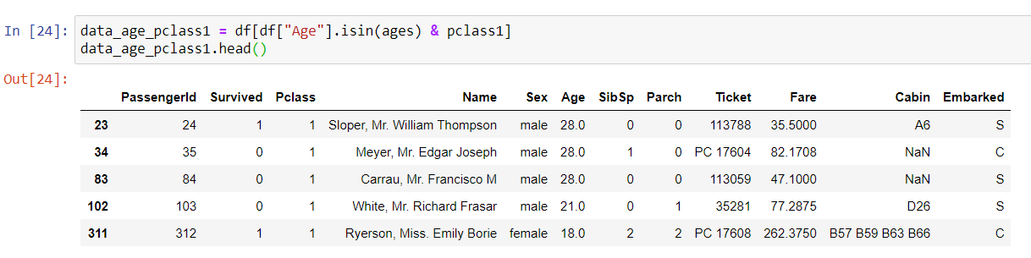
Filtering Baris
Filtering Age dan pclass

Slide 7
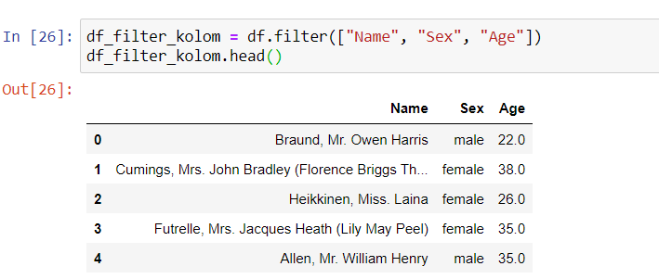
Filtering Kolom

Slide 8
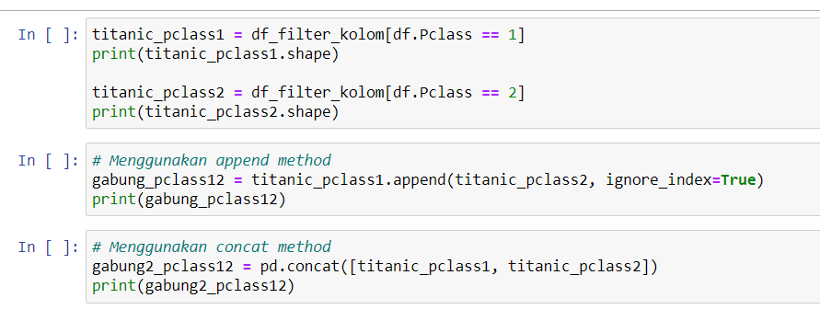
Gabung Dataframe

Slide 9
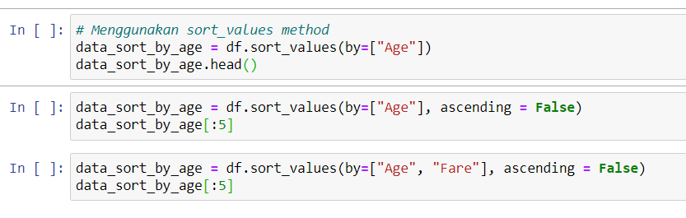
Sorting Dataframe

Slide 10
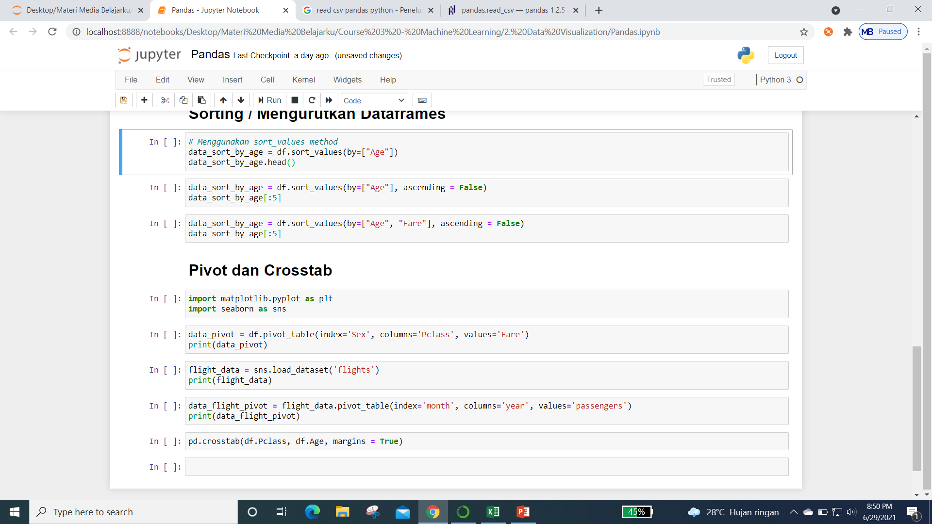
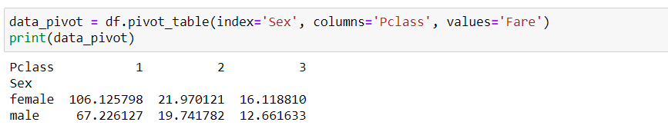
Pivot Tabel

Slide 11
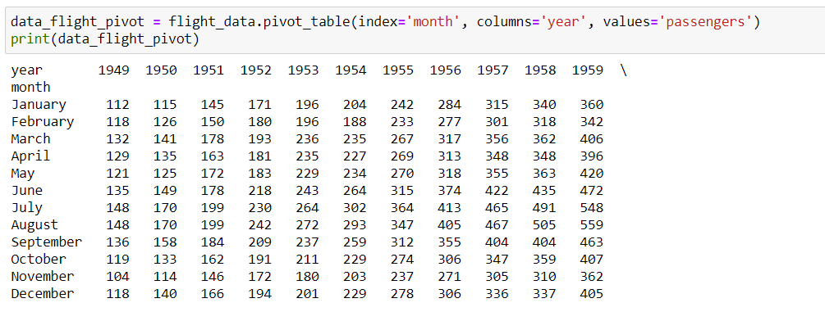
Pivot Tabel

Slide 12
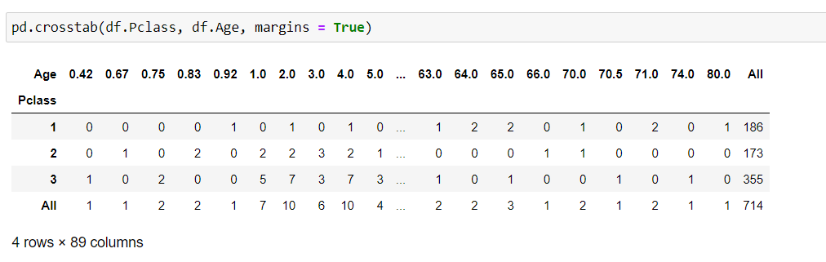
Crosstab Tabel

Slide 13
It’s Time Coding

